Slide 1
Etive OIX project
Using Verify for Local Authority Multi Service Portals (Alpha Project)
TechUK/OIX industry consultation
User Interface and Design
14 March 2018
Together, connected people

Slide 2
Agenda
10:00 – 10:30 | Introduction to the UI challenge – Ian Litton
 | Lessons from Verify “Jobs to be done” Pre-registration and flows
10:30 – 11:00 | Initial mock ups
11:00 - 11:20 | Coffee break
11:20 – 12:00 | Round tables
12:00 – 12:15 | Wrap up

Slide 3
Alpha is NOT:
Producing a fully formed UI
Doing UX research
Considering all UI routes
More work to do in the Beta
UI Challenge
Digital by choice www.digitallogbook.org

Slide 4
Project UI Workshop Led by Pete Gale (pete@idresearch.co.uk)
Lessons from GOV.UK Verify
Digital by choice www.digitallogbook.org

Slide 5
People do things to get the job done
In almost all cases, users are trying to complete a specific job.
That job is almost never identity verification
This makes people more critical of the interaction
Users tend to see identity verification as unwanted additional effort
Those who see verification as an enhancement to
the job they’re doing, are more likely to persist.
Digital by choice www.digitallogbook.org

Slide 6
Jobs are time constrained
Most jobs we see users trying to achieve have a specific deadline
In many cases, users will be penalised for missing deadlines
For many users, ‘try again later’ is not a realistic option
We need to consider how anyone can complete their task now, regardless of the outcome of verification.
Digital by choice www.digitallogbook.org
Notes:
Example - self assessment deadline
Many local authority tasks are also time constrained.
Think about something like applying for school places

Slide 7
Delayed rewards don’t work
The perceived value of a reward decreases with the delay in receiving it.
This effect known as ‘delay discounting’ is a fundamental of human psychology
We need to prioritise delivering immediate value
Digital by choice www.digitallogbook.org
Notes:
Small immediate rewards are stronger -

Slide 8
Users do better with a good model for what’s happening
Users don’t always need to understand the system, but they need a good model for what’s happening (e.g. it’s like your basket when you’re shopping)
Deviations from the user’s model will be ignored, misinterpreted, interpreted as error, or just lead to confusion
Consider the different ways that users
might interpret what’s happening
Digital by choice www.digitallogbook.org
Notes:
Example - what does checkout mean in the context of a shopping basket? The model allows easier interpretaton
Talk about observing people encounter deviations:
Sometimes skip over it
Sometimes actually translate words as they read them
Sometimes blame the system
Distrust will usually lead to a negative interpretation

Slide 9
Federated identity is poorly understood
Most users apply the model of a conventional website registration processes
The presence of third parties disrupts this model
Requests for additional identity sources disrupts this model
Avoid concepts that add further novelty or complexity
Digital by choice www.digitallogbook.org
Notes:
TAlk about how people respond to requests for financial info:
It doesn’t map to the model of ID / It doesn’t map to the task model
It’s frequently interpreted negatively - they’re going to charge me
Same with references to credit history - it’s not registration and it’s not the primary task, so….

Slide 10
Goodwill is a limited resource
Any interaction will either add to or deplete a user’s reserves
When it runs out, people will give up or find another way to achieve their goal
Users tend not to stop at the point where they experienced a problem, but where they finally decide enough is enough.
We need to think about how we can add to reserves of goodwill, as well as how we deplete them
Digital by choice www.digitallogbook.org
Notes:
We may be that users succeed in one part of an interaction, but this negatively affects what comes later
How do we have a positive impact - deliver value early

Slide 11
Most people don’t read that much
It’s not being lazy, it’s the most efficient approach in most cases.
Interaction tends to be a richer source of information on how a system behaves
There’s no point reading about issues that may not happen
Early in the interaction, no one expects it to go wrong
Provide information in small, relevant chunks,
at the point where it’s needed.
Digital by choice www.digitallogbook.org
Notes:
Research anecdote about not reading

Slide 12
Any interaction has an irreducible level of complexity
The interesting question is whether we ask our users to deal with it or whether we do the hard work ourselves.
In almost all cases we get better outcomes when we deal with it ourselves, as our developers are more motivated and we have better quality control.
Look for opportunities to take complexity away
from users and handle it ourselves.
Digital by choice www.digitallogbook.org

Slide 13
Opportunities
Opportunities
Digital by choice www.digitallogbook.org

Slide 14
Immediate benefit is what counts
So far, the Verify federation has struggled to deliver immediate benefit
There is considerable opportunity here
Some interactions are starting to demonstrate this
Digital by choice www.digitallogbook.org
Notes:
Discuss the registration by mobile interaction
18F prototypes
Much stronger motivator than “You can use your Verify identity for…”

Slide 15
Identity verification shouldn’t be a barrier
Using identity as a means to enhance the way we deliver services, means:
Everyone can get the job done, regardless of the effectiveness of our backend
Users are motivated to achieve immediate benefits
Digital by choice www.digitallogbook.org
Notes:
Talk about progressive enhancement.
we’re not excluding users from accessing services
Users can see the value that they’re going to get by going through verification
Talk about the example of completing a paper passport form - you look at the form before you attempt to complete it.
Imagine a world where your passport form was like an exam - You weren’t allowed to look at it until you had to complete it
Imagine how stressful that would be?

Slide 16
Opportunities for new tasks
Although users focus ruthlessly on getting the job done, there are opportunities
Once the task is completed, stress levels drop presenting various opportunities:
Visual processing becomes less focused
Working memory improves
Ability to encode long term memory and to learn improves
They become more open to taking on additional tasks
Digital by choice www.digitallogbook.org
Notes:
This is pretty much the basis for most of the cross promotion that amazon does.
Cross promoting on product pages (once you’ve found the thing)
Cross promoting after checkout (once you’ve bought the thing)

Slide 17
Use cases vs ‘jobs to be done’
Digital by choice www.digitallogbook.org

Slide 18
What users could do; what they will do
Focus on the jobs users want to achieve
“Complete your LOA2 registration when we have more data” as a solution to:
Use case: Registering for LOA2 identity account.
Job: I need to submit my tax return before the deadline
Digital by choice www.digitallogbook.org
Notes:
Before we prioritise - what are we prioritising?
Jobs is a much more valuable contruct that use cases
Discuss why…

Slide 19
Alpha jobs to be done
Get on the Housing Register
Move to another borough
Digital by choice www.digitallogbook.org

Slide 20
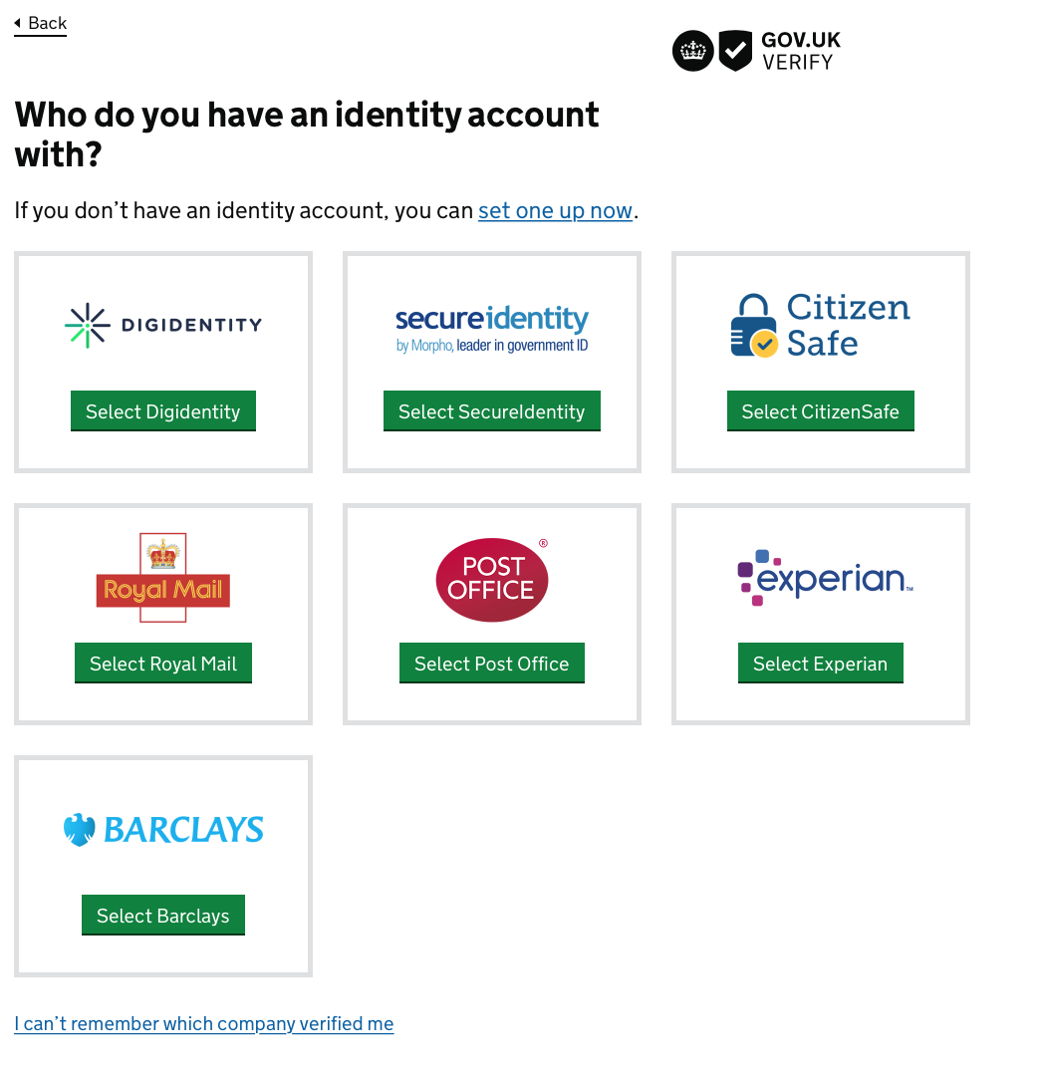
Pre-registration and flows
Digital by choice www.digitallogbook.org

Slide 22
Initial mock-ups
Have created straw man screens
Not crafted or highly designed
Intended to stimulate discussion
Digital by choice www.digitallogbook.org

Slide 23
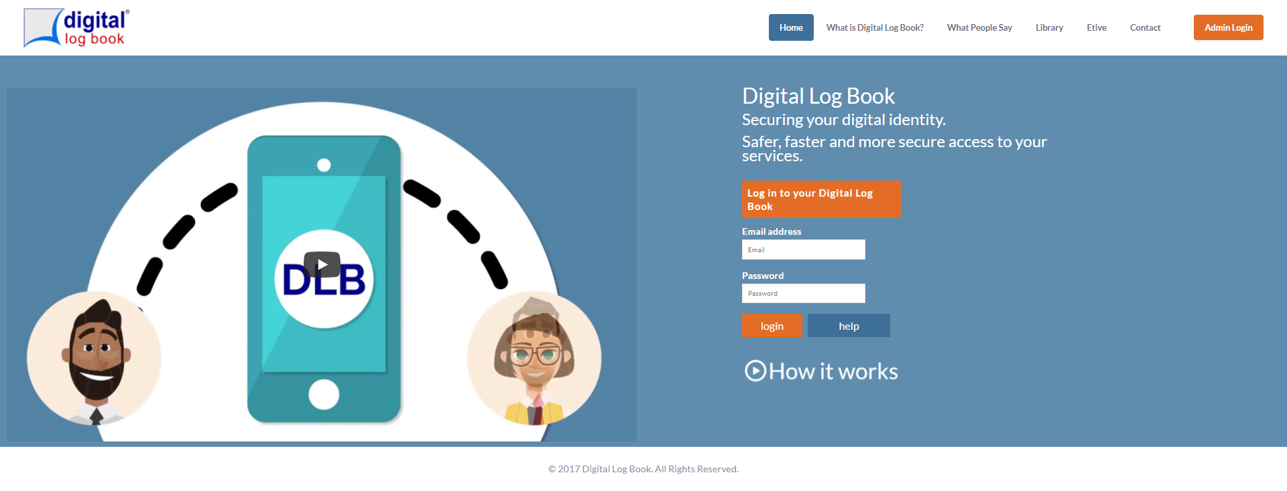
DLB Log In Screen
www.digitallogbook.org
Notes:
The Log In screen
User friendly designed for mobiles and tablets:
Could say that we will add the Verify logo to this screen

Slide 24
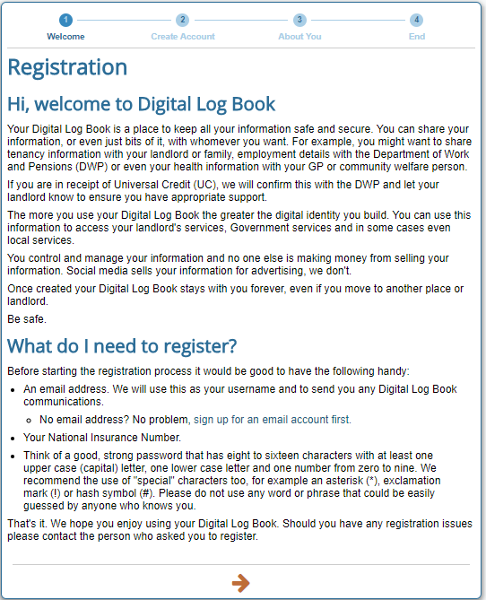
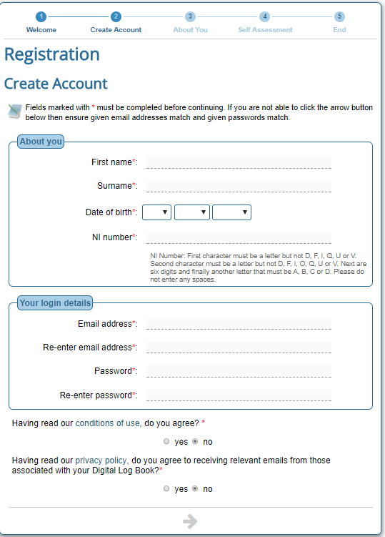
DLB Registration Screen
www.digitallogbook.org
Notes:
Registration process- currently being simplified
2 step process: User completes basic details, signs up to Terms and Conditions, email link to authenticate account followed by security questions.
A questionnaire can be added to check what the user understands about the rights and responsibilities of being a tenant
The registration link is personalised to your organisation so the correct branding and content is provided to the User
Say that this will be replaced with a Verify LoA0 account in the first instance. Won’t need all of this info e.g. NINO, to get an LoA0 account

Slide 25
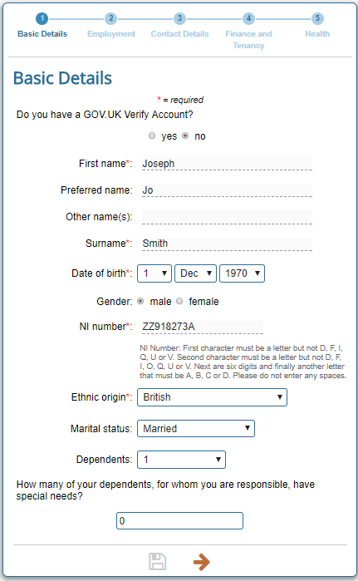
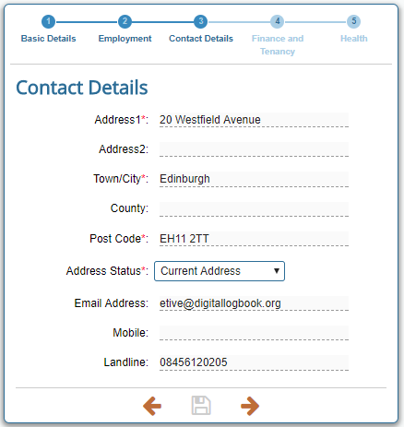
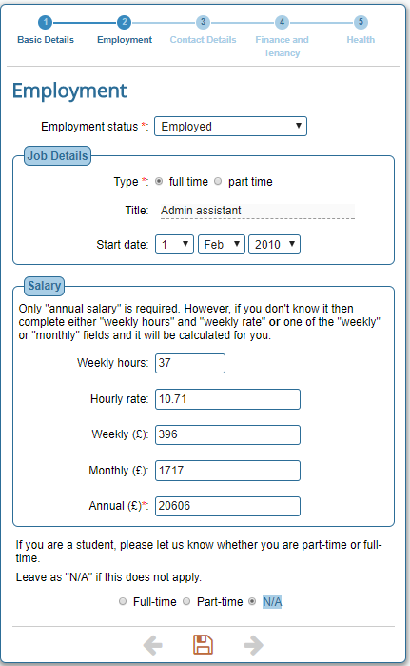
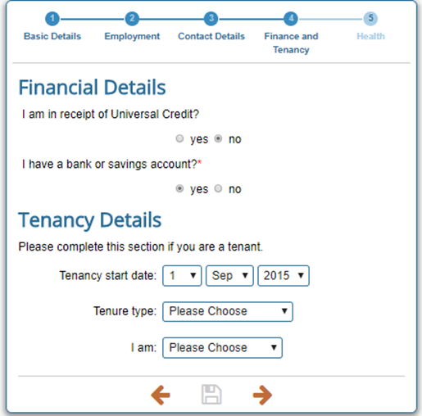
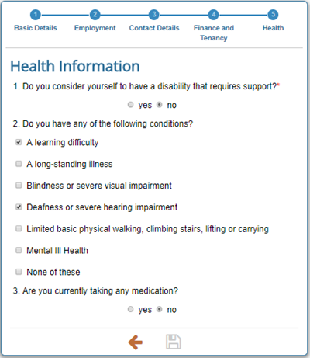
Personal Data
www.digitallogbook.org
Notes:
The personal data collected during registration can be accessed and amended from the “Details” tile
Make the point that this is the sort of info that the LAs will be verifying as part of their onboarding and eligibility checking processes. This can happen after the LoA0 account has been created.

Slide 26
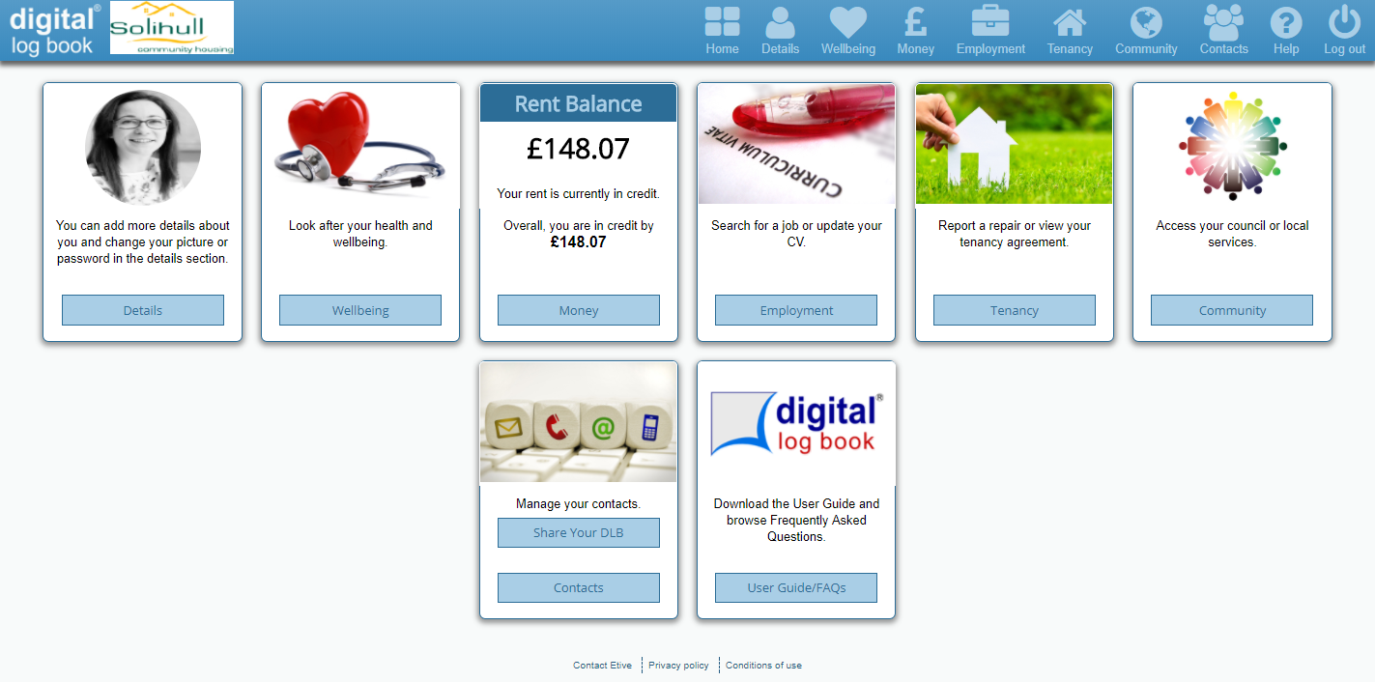
Sample Dashboard
www.digitallogbook.org
Notes:
Need to be clear at what point the user gets all this – once the eligibility checks have been done?
Once Logged In, the user sees their Dashboard
Tiles are a mix of standard (Details/ Contacts/ User Guide) and those chosen by their Landlord
The Rent Balance on this Dashboard is updated live – we can add a prompt and link to pay rent
Users access the different tile content using the menu or tile button

Slide 27
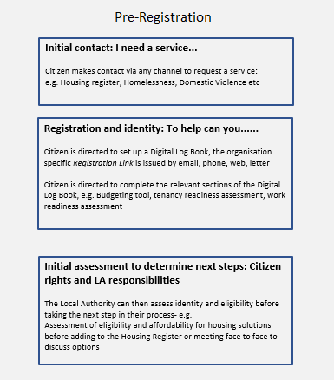
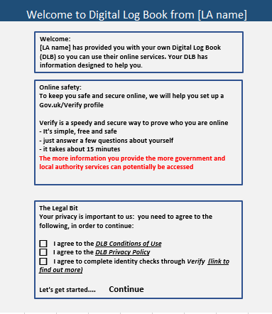
Registration
www.digitallogbook.org
Notes:
Make the point that this is the bit we are really looking for feedback on – these screens will be crucial.

Slide 28
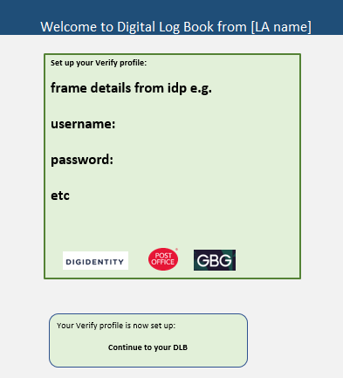
Registration
www.digitallogbook.org
Notes:
Make the point that we need a discussion around the IdP screens. What will they look like for LoA0? What dialogue will there be with the user? How and when do we communicate with the user the wider use of a Verify ID (once up to the right LoA)?
Make the point that pre-registration would allow us to go straight from DLB to the LA’s partner IdP. No need to go to a hub to choose an IdP. Just showing 3 here as they are the project partners

Slide 29
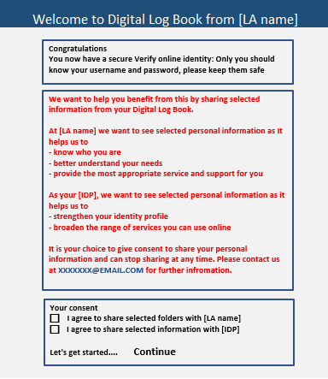
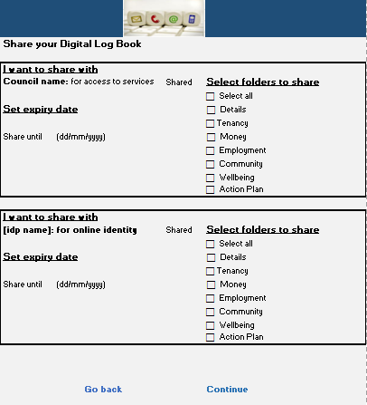
Registration
www.digitallogbook.org
Notes:
Need to make the point here that we need to work on how we frame the consents relating to the IdP. The second screen might not be appropriate for the IdP, but we do need to make it clear what sort of info is going to be shared.

Slide 30
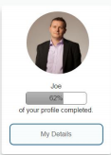
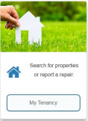
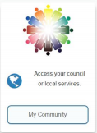
Service Dashboard
Start sharing
Stop sharing
Hackney Services
Click here to access LBTH/Hackney and government online services.
www.digitallogbook.org
Notes:
Note I’ve put the thumbs up and stop hand in the right place and reduced their size!!

Slide 31
Services linked to LoAs
Hackney Services
Click here to access LBTH/Hackney and government online services.
Services that can be done online based on your Level of Access
LoA0 LoA1 LoA2
New bin Travel pass Council tax reduction
www.digitallogbook.org
Notes:
Based on your LoA will determine what services you can use online.
Almost good to have a menu of services with a different LoA against them which might encourage people to increase their LoA – loss aversion – but also still have a route to access that service. Depending on LoA they can either complete all online or access elsewhere.

Slide 32
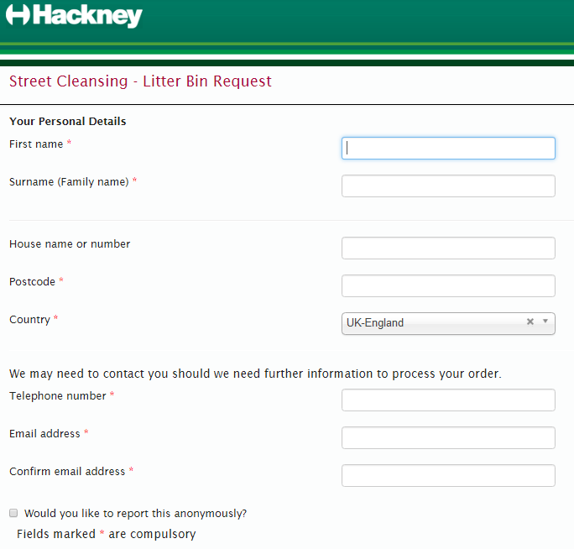
LoA 0
For bin collection confirmation of resident and address.
Service request can be sent off from the DLB.
www.digitallogbook.org

Slide 33
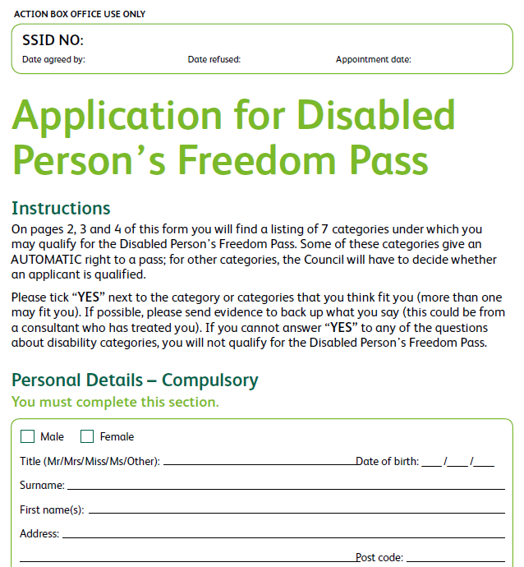
LoA 1
7 page form to be completed
www.digitallogbook.org
Notes:
If LoA1 you can do this without having to prove age or address.
What would be the prompt to encourage someone to elevate their LoA and do it online rather then go off line.
If they don’t have a strong enough Id to do what we want them to do what do we need to do to get them there.

Slide 34
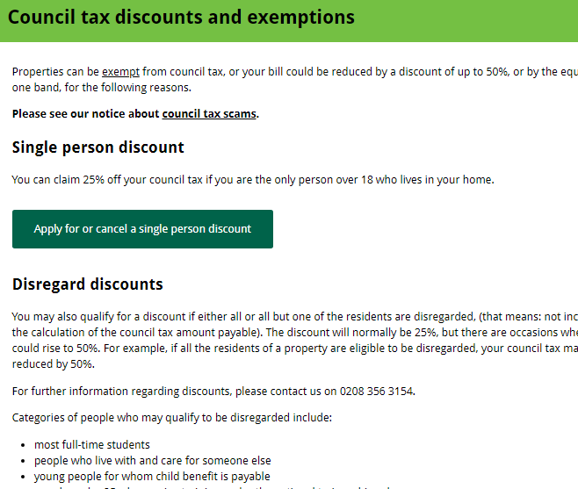
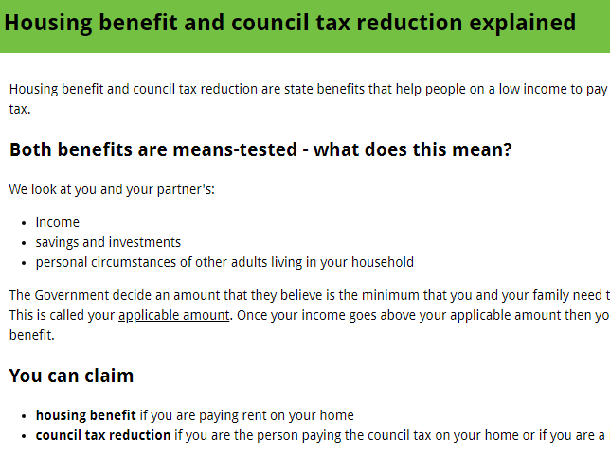
LoA 2
www.digitallogbook.org

Slide 35
Round Tables
Digital by choice www.digitallogbook.org

